Slide 1
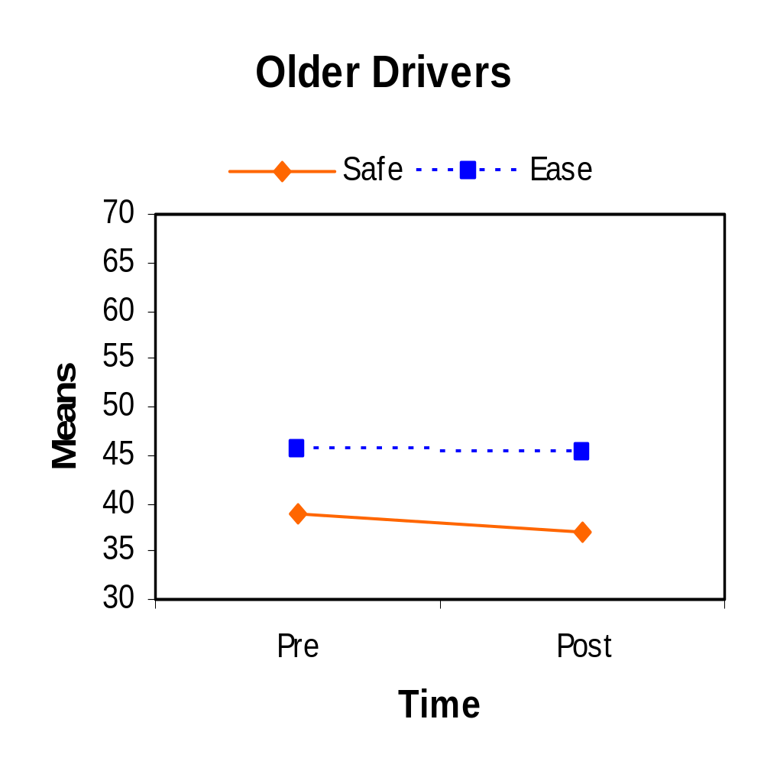
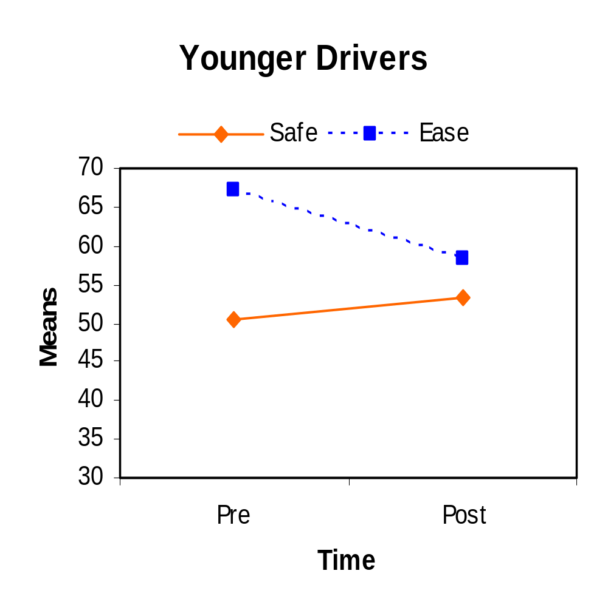
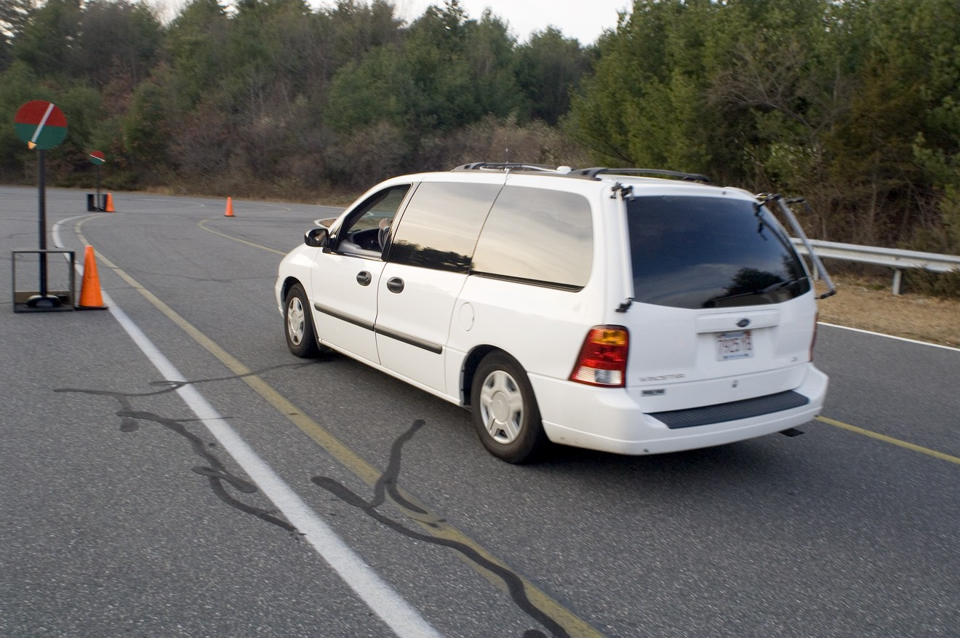
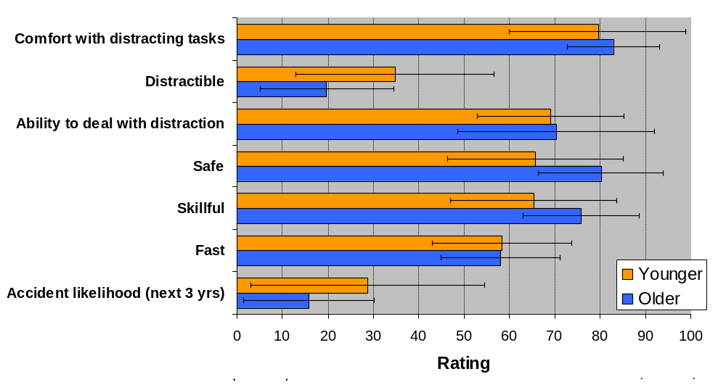
Title
Authors
Does Exposure to Distraction in an Experimental Setting Impact Driver Perception of Cell Phone Ease of Use and Safety?
Angela Garabet, William J. Horrey, Mary F. Lesch
Liberty Mutual Research Institute for Safety, Hopkinton, MA
Abstract
Results
Previous work has suggested that people who use cell phones while driving may overestimate their driving skills and ability to deal with distractions¹. Examined is the possibility that simple exposure can shift attitudes towards cell phone safety and ease of use. Younger and older drivers reflected on driving and task performance while engaged in distracting tasks on a hands-free or hand-held cell phone. Hands-free phones were consistently rated easier to use and safer than hand-held phones by both age groups despite equivalent driving performance decrements. After exposure to distraction, younger drivers’ perception of the ease of use declined, with no change in safety ratings. Older drivers’ ratings of ease or safety did not change. A priori subjective ratings on various dimensions of driver skill and distraction showed different correlation patterns for each age group.
Ease of Use and Safety Ratings
Rating Correlations
Legend
For young drivers, driving skill related only to the ability to drive fast (r= .47)
Increased distractibility while driving relates to decreased skill ratings
(r = -.47) for older adults only
For older drivers, driving skill also related to safety (r = .60), accident likelihood (r = -.42) but not driving fast
Older
Drivers
Ability to
Younger
Deal with
Drivers
Distraction
Skillful
r = .44
r = .58
Distractibility
r = .62
Comfort
r = -.59
Level
Dealing with
Distracting
r = - .45
Tasks
r = -.57
Accident
r = .62
Fast
Likelihood
Safe
Subjective ratings on scale from 0 (incredibly unsafe or difficult) to 100 (incredibly easy or perfectly safe)
Significant Spearman correlations shown p < .05
Equivalent driving performance decrements for hand-held and hands-free phones²
Hands free phones rated easier to use & safer by both age groups (p<.001)
Younger drivers rated both hand-held and hands-free phones easier to use & safer than did older drivers both
pre- and post-exposure (p< .008)
Post- exposure, younger drivers rated the ease of use for both phone types lower (p < .04)
For older drivers, no change in ratings after exposure
Different Patterns Between the Phone Types and Age Groups for Pre-exposure Ratings
Equipment
 | Older Drivers | Younger Drivers
Hand held Ease | Skill (r=.46) | No correlations
Hand held Safety | No correlations | Distractibility (r = .45)
Hands free Ease | No correlations | No correlations
Hands free Safety | No correlations | Distractibility (r = .44) Comfort in dealing with distraction (r = .41)
2002 Ford Windstar
1/2 mile closed-loop delineated track
Signalized intersection
Pace clocks (speed control)
Hand-held, hands-free cell phone
Pre-exposure Comparisons to the Average U.S. Driver
Conclusions
Participants
Discrepancy in safety perception between hand-held and hands-free despite same performance results. It is possible that hands-free phones promote inappropriate perception of safety.
Young drivers may initially overestimate ease of use and the exposure allowed modification of initial impressions.
Younger drivers may have a disconnect between dealing with distraction and driving skill.
Ability to deal with distraction and comfort in doing so positively related to skill for older adults only.
Different correlation patterns may suggest important dimensions to target in future interventions.
20 older drivers (M = 64 yrs, SD = 7)
21 younger drivers (M = 23 yrs, SD = 5)
Procedure
1.5 hour distraction exposure²
Two phone tasks: 20 Questions (Guessing an object in as few questions as possible); mental arithmetic³
Driving only & distraction tasks only
After each block, self-report measures were taken:
  NASA-TLX⁴ (mental demand & effort, frustration, time pressure, physical demand)
  Phone performance
  Driving performance (lane keeping, pace clock,
  stop light)
Bias for higher ratings on all dimensions for both age groups
Older drivers reported higher driving skill, safety, and being less prone to distraction despite lower ratings for cell phone ease & safety
Age-related differences in ease & safety ratings of cell phones but not in ability & comfort dealing with distraction
  References:
1. Wogalter, M.S. & Mayhorn, C.B. (2005). Perceptions of driver distraction by cellular phone users and non-users. Human Factors, 47, 455-467.
2. Horrey, W.J., Lesch, M.F. & Garabet, A. (2007). Awareness of performance decrements due to distraction in younger and older drivers. Proc. of the 4th International Driving Symposium on Human Factors in Driver Assessment, Training and Vehicle Design, Stevenson, WA.
3. Gronwall, D.M.A. (1977). Paced auditory serial-addition task: A measure of recovery from concussion. Percept. Mot. Skills, 44, 367-373.
4. Hart, S.G. & Staveland, L.E. (1988). Development of NASA-TLX (Task Load Index): Results of experimental and theoretical research. In P.A. Hancock & N. Meshkati (Eds.), Human Mental Workload. Amsterdam: North Holland
The authors would like to thank Peter Teare, Eric Jones, Richard Holihan and Ed Correa for their upkeep and maintenance of the instrumented van and Jonathan Gallimore and Peg Rothwell for poster assistance.

